Slide 1

Rel-ID:Relation Identifier Member: Victor Ouko Mentor: Kuldeep Singh

Slide 2
Project Overview
’Rel-ID’ is a module that solves relation identification tasks, intended for use in question answering applications.
Example: Who is the wife of Barack Obama?
Entity: Barach Obama
Relation: Spouse of
DBpedia relation entry: db:spouse

Slide 3
Objective
To extract relations from given queries in the most efficient way through elastic search.

Slide 4
Tasks (Module)
Relation recognition
Relation matching

Slide 5
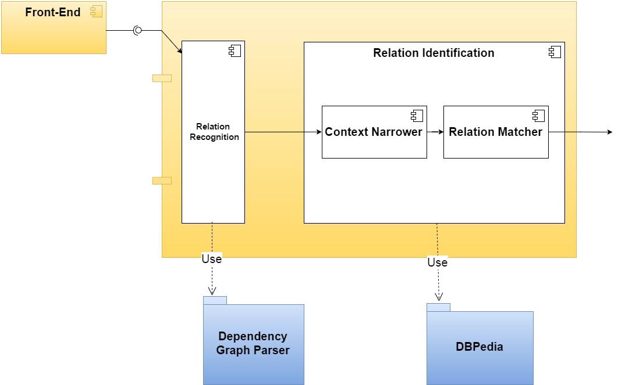
System Architecture

Slide 6

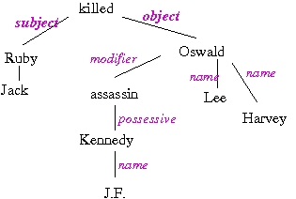


Implementation
.
Elastic Search Engine
Input
Generate Relations
Relation Matching
Stanford NLP Parser
Patty Data-Set File
Text Outputs

Slide 7
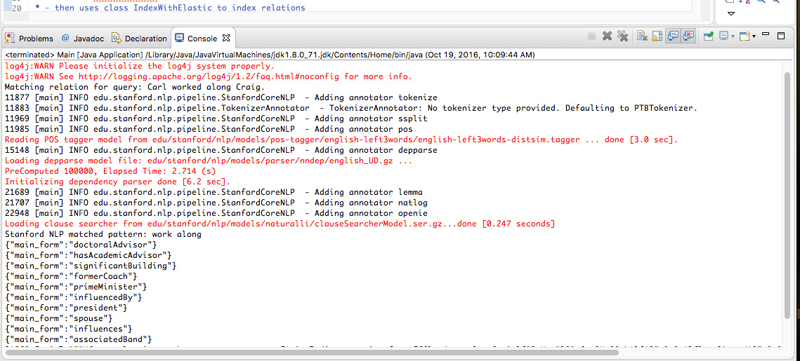
Project Results
OpenIE

Slide 8
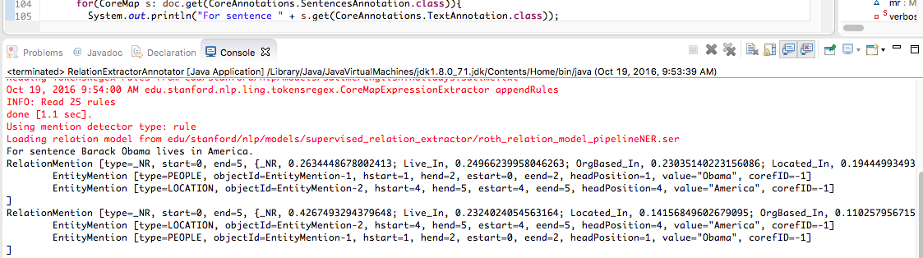
Project Results
Relation Extractor

Slide 9
Project Results
For the given natural language question, corresponding DBpedia relation is extracted successfully.
Elastic search has been implemented over PATTY to improve the search process.

